Slide 1



University Institute of Engineering
DEPARTMENT OF COMPUTER SCIENCE & ENGINEERING
Subject Name: Software Engineering
Subject Code: 23CST-206
Er. Jagmeet Kaur
E8387
ASSISTANT PROFESSOR
CSE
DISCOVER . LEARN . EMPOWER

Slide 2
Topics covered
Data Dictionary
Structured Chart
Pseudo Code

Slide 3
Data Dictionaries
A data dictionary lists all data elements appearing in the DFD model of a system.
The data items listed contain all data flows and the contents of all data stores looking on the DFDs in the DFD model of a system.
A data dictionary lists the objective of all data items and the definition of all composite data elements in terms of their component data items.

Slide 4
Data Dictionaries
For example, a data dictionary entry may contain that the data grossPay consists of the parts regularPay and overtimePay.
grossPay = regularPay + overtimePay
For the smallest units of data elements, the data dictionary lists their name and their type.

Slide 5
Data Dictionaries
A data dictionary plays a significant role in any software development process because of the following reasons:
A Data dictionary provides a standard language for all relevant information for use by engineers working in a project. A consistent vocabulary for data items is essential since, in large projects, different engineers of the project tend to use different terms to refer to the same data, which unnecessarily causes confusion.
The data dictionary provides the analyst with a means to determine the definition of various data structures in terms of their component elements.

Slide 6
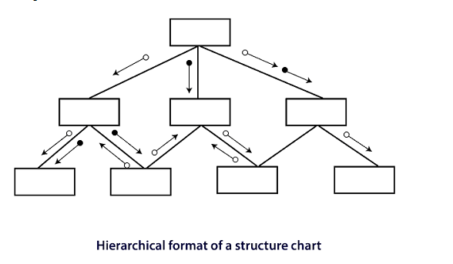
Structured Charts
It partitions a system into block boxes. A Black box system that functionality is known to the user without the knowledge of internal design.

Slide 7
Structured Charts
Structured Chart is a graphical representation which shows:
System partitions into modules
Hierarchy of component modules
The relation between processing modules
Interaction between modules
Information passed between modules

Slide 8
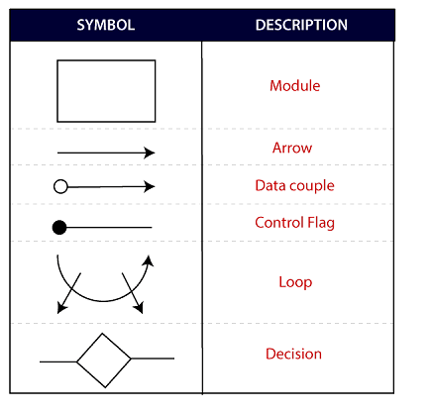
Structured Charts
The following notations are used in structured chart:

Slide 9
Pseudo Code
Pseudo Code is system description in short English like phrases describing the function.
It use keyword and indentation. Pseudo codes are used as replacement for flow charts.
It decreases the amount of documentation required.

Slide 10
REFERENCES
Reference Books:
Suman Ugrasen, “Software Engineering - Concepts and Practices”, First Edition, Cengage.
Mohammad Ali Shaikh, “Software Engineering with UML”, Third Edition, Notion Press.
Somerville Ian, “Software Engineering”, Addison Wesley, 8th Edition.
Text Books:
Pressman Rogers, “Software Engineering: A Practitioner's Approach”, Sixth edition. Patterson and Hennessy, “Computer Architecture” , Fifth Edition Morgaon Kauffman.
Rajib Mall, “Fundamentals of Software Engineering’’, Fourth Edition, Pearson, PHI.
Reference Website
https://www.geeksforgeeks.org/software-engineering-structure-charts/

Slide 11
THANK YOU

